Slide 1
Annual Interagency Accessibility Forum
Enabling Missions through Accessible Technology – Leaving No One Behind
October 6 & 7, 2020
Mobile Accessibility
Emerging technology as it relates to our devices, allowing us to be mobile for persons with disabilities

Slide 2
Agenda
What Are Mobile Devices and Mobile Applications?
What Complexities Do Mobile Devices Bring to Accessibility?
What Are Some Mobile Accessibility Challenges?
Are Accessibility Regulations Different for Mobile?
What Are Some Solutions to Mobile Accessibility Challenges?
What’s New in Mobile Accessibility?
Questions

Slide 3
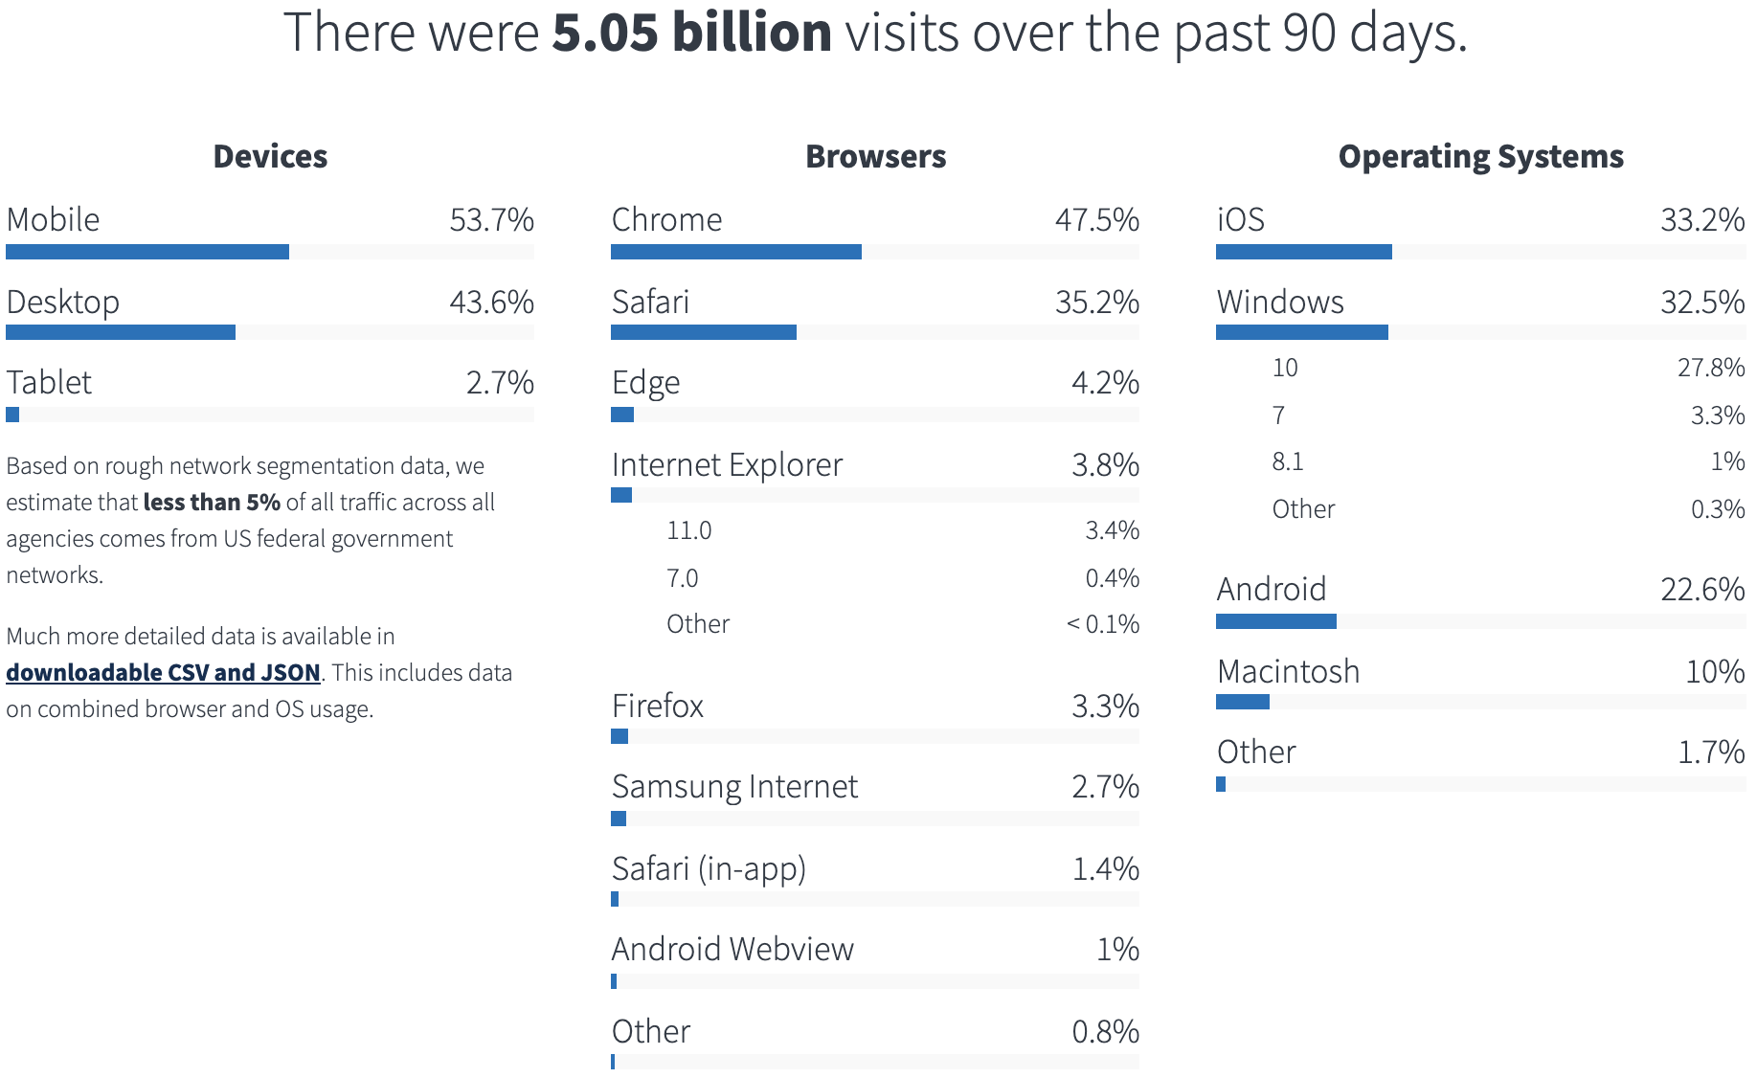
Mobile Traffic To Federal Websites on analytics.usa.gov

Slide 4
What Are Mobile Devices and Mobile Applications?
Mobile Devices
Mobile Applications
Phone
Tablet
Watch
Native Apps
Web
Responsive Web Design (RWD)
Progressive Web Applications (PWA)
Accelerated Mobile Pages (AMP)

Slide 5
What Complexities Do Mobile Devices Bring To Accessibility?
The Wide Variety
Makes and models
Sizes
Operating systems
Web browsers
Computing Power and Storage
Software and websites can be large and use a lot of bandwidth
Physical Size
Graphics and text are often too small
Touch area gets reduced
Interface
Not keyboard focused
Touch vs. mouse can cause usability problems
Speech control is not always available

Slide 6
What Complexities Do Mobile Devices Bring? (continued)
Development and Testing
Physical devices are required
Single codebase development
Zoom functionality is not always optimal

Slide 7
What Are Some Mobile Accessibility Challenges?
Audio – Deaf or Hard of Hearing (HoH)
Captioning or sign language interpreters
Vision – Blind, Low Vision, or Color Blind
Audio descriptions
Screen magnification
Font sizes
Color contrast
Mobility
Input devices
Voice commands
Cognitive, Learning, Neurological
Page clutter or inconsistency
Animations or flashing content
Unnecessary formatting
Keyboard focus visibility

Slide 8
Are Accessibility Regulations Different for Mobile?
Section 508 applies to all digital content, not just websites
Mobile Accessibility: How WCAG 2.0 and Other W3C/WAI Guidelines Apply to Mobile https://www.w3.org/TR/mobile-accessibility-mapping/
It’s not native vs. web; all digital content, products, and services must be accessible.
“3rd party suppliers say that there are no standards for mobile, so they feel that WCAG [Web Content Accessibility Guidelines] doesn't apply to mobile devices, and therefore they don't have to do it.” (See Resources: W3C Mobile Accessibility Challenges)

Slide 9
Are Accessibility Regulations Different for Mobile? WCAG
Section 508 of the Rehabilitation Act of 1973, W3C WAI WCAG 2.0, User Agent Accessibility Guidelines (UAAG) 2.0, and Authoring Tool Accessibility Guidelines (ATAG) 2.0 include information on mobile (See Resources)
Key WCAG components under the four “POUR” principles
Perceivable – Both content and user interface components must be presented to users in ways they can perceive.
Operable - User interface components and navigation must be operable.
Understandable - Information and the operation of user interface must be understandable.
Robust - Content must be robust enough that it can be interpreted reliably by a wide variety of user agents, including assistive technologies.

Slide 10
Some Solutions To Mobile Accessibility Challenges
Mobile (native and web)
Focus on touch targets and placement
Keep device gestures simple and provide feedback
Ensure consistent layout and templates
Provide easy methods for data entry
Check color contrast
Review content (written in plain language, spaced well for readability)
(See Resources: 6 Step Mobile App Accessibility Checklist)

Slide 11
What’s New in Mobile Accessibility? - Audio
Stereo to Mono
When using a single headphone or have hearing in one ear, direct the audio into a specific ear.
Sound Amplifier
Hear things more clearly by boosting sound, filtering background noise for how you hear best.
Track Hearing Health
Apps track decibel levels of the sounds around you, identifying damaging noise levels.
Hearing Aid Support
Based on a Bluetooth technology, it lets you manage audio levels from your device
Haptic Feedback
Beeps and chimes aren’t the only way to know you’ve received a notification.

Slide 12
What’s New in Mobile Accessibility? - Vision
Use Gestures to Navigate Your Device
Explore content using gestures to navigate item-by-item as well as by touch
Bluetooth Braille Display
Allows one to connect a refreshable braille display
Use Camera Images
Use your camera to help you identify what’s nearby
Designing Safer Web Animations
Use CSS to create reduced-motion media features (See Resources: Designing With Reduced Motion For Motion Sensitivities)

Slide 13
What’s New in Mobile Accessibility? - Mobility
Bluetooth Keyboard Navigation
Support for Bluetooth keyboard navigation that enables screens, menus, and buttons to be accessed using an external keyboard
Switch Access
Use built-in features as well as switches, a joystick, or other adaptive devices to control what’s on your screen
Customize Gestures
Make other features accessible with just a touch
Manage your house with just your voice
With just your voice, turn on the lights, start the coffee, open the blinds, or play the latest hit song just by speaking

Slide 14
What’s New in Mobile Accessibility? – Learning
Spoken Feedback
Gives verbal feedback including text corrections and word suggestions as you type
Browser Readers
Strips away ads, buttons, and navigation bars, allowing you to focus on just the content you want

Slide 15
What’s Next in Mobile Accessibility?
Faster Devices
Faster computing
Mobile Application Growth
Expected to grow by 45% in the next few years
Artificial Intelligence and Machine Learning
Real time transcriptions or conversations
Identifying Images and faces; image recognition
Brain-Controlled Devices
Department of Defense is working on brain-controlled devices
What’s next? The sky’s the limit!
(See Resources: Why Accessibility Is a Critical Piece of Tech Trends for 2020)

Slide 16
Additional Mobile Accessibility Resources – Government
Government Resources
Section508.gov – How to create accessible products, tools and training, find your agency’s 508 Program Manager, testing methods, and more
Digital.gov – Guidance on building better digital services in government
Resources, news, guides, events, services, and communities of practice
Plain Language Community of Practice https://digital.gov/communities/plain-language/
IT Accessibility and Section 508 Community of Practice https://digital.gov/communities/it-accessibility-section-508/
U.S. Web Design System (USWDS) – Public-facing websites and digital services should use USWDS to meet eight specific requirements of 21st Century IDEA https://designsystem.digital.gov/
Accessibility for Teams – A ‘quick-start’ guide for embedding accessibility and inclusive design practices into your team’s workflow https://accessibility.digital.gov/
PlainLanguage.gov – Law and requirements, guidelines, checklists, style guides, and more.
Access Board – Develops and maintains design criteria
Guidelines, standards, training, webinars, and research https://www.access-board.gov

Slide 17
Additional Mobile Accessibility Resources - Laws
Laws
Section 508 of the Rehabilitation Act and Section 255 of the Communications Act https://www.access-board.gov/guidelines-and-standards/communications-and-it
Section 508 Applicability & Conformance Requirements (WCAG 2.0) https://www.section508.gov/create/applicability-conformance
Plain Writing Act https://www.plainlanguage.gov/law/
21st Century Integrated Digital Experience Act
21st Century IDEA aims to improve the digital experience for government customers and reinforces existing requirements for federal public websites https://digital.gov/resources/21st-century-integrated-digital-experience-act/
Americans with Disabilities Act (ADA)
Department of Justice has developed technical assistance and guidance to help covered entities understand their ADA obligations with regard to accessible technology https://www.ada.gov/access-technology/guidance.html

Slide 18
Additional Mobile Accessibility Resources – W3C
World Wide Web Consortium (W3C)
W3C Web Accessibility Initiative (WAI) https://www.w3.org/WAI/
How to Meet WCAG 2 (Quick Reference) https://www.w3.org/WAI/WCAG21/quickref/
Mobile Accessibility: How WCAG 2.0 and Other W3C/WAI Guidelines Apply to Mobile https://www.w3.org/TR/mobile-accessibility-mapping/
User Agent Accessibility Guidelines (UAAG) 2.0 https://www.w3.org/TR/UAAG20/
Authoring Tool Accessibility Guidelines (ATAG) 2.0 https://www.w3.org/TR/ATAG20/
Mobile Accessibility at W3C https://www.w3.org/WAI/standards-guidelines/mobile/
W3C Mobile Accessibility Challenges https://www.w3.org/WAI/GL/mobile-a11y-tf/wiki/Mobile_Accessibility_Challenges
W3C Challenges with Accessibility Guidelines Conformance and Testing, and Approaches for Mitigating Them https://www.w3.org/TR/accessibility-conformance-challenges/
Mobile Accessibility: How WCAG 2.0 and Other W3C/WAI Guidelines Apply to Mobile https://www.w3.org/TR/mobile-accessibility-mapping/

Slide 19
Additional Mobile Accessibility Resources - Articles
Articles
Why Accessibility Is a Critical Piece of Tech Trends for 2020 https://www.boia.org/blog/why-accessibility-is-a-critical-tech-trend-for-2020
6-Step Mobile App Accessibility Checklist https://blog.usablenet.com/mobile-app-accessibility-techniques-for-inclusive-design-part-1
Design-For-All: Best Practices for Mobile Accessibility https://freeportmetrics.com/blog/design-for-all-best-practices-for-mobile-accessibility/
Mobile Applications and Litigation: Why Accessibility is Important and What to Consider before Launching, Part 2 of 2 https://www.microassist.com/digital-accessibility/mobile-application-accessibility-part-2-of-2/
Designing With Reduced Motion For Motion Sensitivities https://www.smashingmagazine.com/2020/09/design-reduced-motion-sensitivities/
"Access," a Short Film About Accessibility https://medium.com/@chrishiggins/announcing-access-a-short-film-about-accessibility-2812ef64a13b

Slide 20
Call to Action
Mobile accessibility is simply a good development practice!
Visit the Digital Dashboard to check your mobile score https://www.digitaldashboard.gov/
Resource: Mobile User Experience Guidelines https://digital.gov/resources/mobile-user-experience-guidelines/
Blog: Is Your Site Mobile-Friendly? https://digital.gov/2015/10/23/is-your-site-mobile-friendly/
Resource: 8 Principles of Mobile Friendliness https://digital.gov/guides/mobile-principles/
Join the Federal MobileGov Community of Practice https://digital.gov/communities/mobile/
Utilize the Federal Crowdsource Mobile Testing Program https://digital.gov/services/mobile-application-testing-program/

Slide 21
THANK YOU For attending …

Slide 22
Questions?

